Slide 1


Healthcare Trends and Cost Analysis in California:
CALIFORNIA HEALTH RECORDS
25/3/25
A Data-Driven Approach to Improving Patient Outcomes
Group 4: SABI DA25

Slide 2
Agenda
Science Presentation
1.
Introduction
2.
About The Dataset
3.
Aim
4.
Problem Statement
5.
Objective

Slide 3
Agenda
6.
Research Questions
7.
Key Findings & Conclusion
8.
Recommendations

Slide 4
Introduction
Group 4 SABI DA25
INTRODUCTION
Healthcare focuses on preventing, diagnosing, and treating diseases to improve well-being. It involves hospitals, medical professionals, and insurance systems working together. Data-driven insights help optimize patient care, resource allocation, and cost management, addressing challenges like rising expenses and unequal access to services.

Slide 5
Introduction
Group 4 SABI DA25
ABOUT THE DATASET
The dataset contains 56,000 patient records with detailed information on demographics, medical conditions, hospital admissions, billing, and treatments. Key attributes include Age, Gender, blood Type, Medical Condition, Admission Type, Insurance Provider, Billing Amount, Medication, and Test Results.
This Dataset was sourced from Kaggle via the link https://www.kaggle.com/datasets/prasad22/healthcare-dataset
It contains 56,500 rows and 15 columns.

Slide 6
Introduction
Group 4 SABIDA25
AIM
To analyze patient demographics, hospital admissions, medical conditions, and billing trends to identify key patterns and insights that can improve healthcare management and service delivery.

Slide 7
Introduction
Group 4 SABI DA25
PROBLEM STATEMENT
The healthcare industry lacks data-driven insights into patient demographics, admission trends, and financial management, hindering optimal resource allocation, cost reduction, and patient care improvement. This project takes a Data-Driven approach to improving patient outcomes in the City of California.

Slide 8

OBJECTIVES
Objective
Group 4 - SABI DA25
1. To examine patient demographics (age, gender, and blood type) and their correlation with medical conditions.
2. To analyze hospital admission trends, including the frequency of admissions by hospital, type of admission, and seasonal variations.
3. To assess the financial aspects of healthcare, such as variations in billing amounts by medical condition, insurance provider, and hospital.
4. To evaluate doctor and medication trends, identifying which doctors handle the most patients and which medications are most frequently prescribed.

Slide 9
Research Questions
Group 4 - SABI DA25
RESEARCH QUESTIONS
1. How do patient demographics (age, gender, blood type) correlate with medical conditions?
2. What are the trends in hospital admissions based on admission type and seasonality?
3. How does the length of hospital stay vary across different admission types and medical conditions?
4. What is the relationship between medical conditions and prescribed medications?
5. How do billing amounts vary by insurance provider and medical condition?

Slide 10
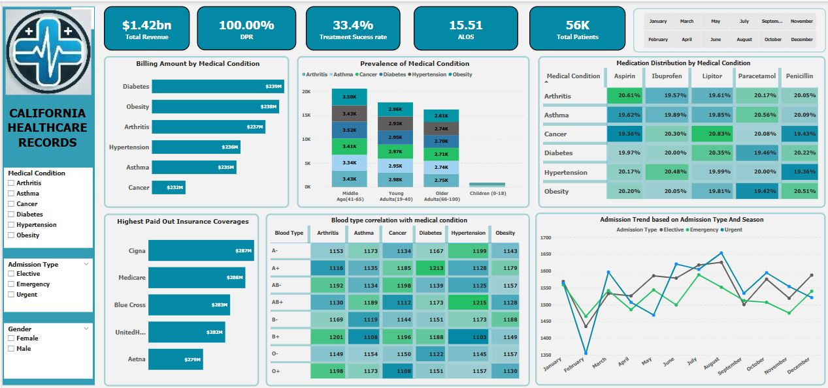
Analytics
Drawing a Conclusion
Group 4 SABI DA25

Slide 11
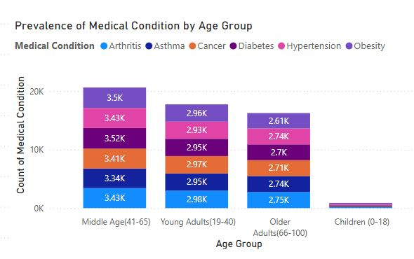
Age Correlation
Science Presentation
1. How do patient demographics (age, gender, blood type) correlate with medical conditions?

Slide 12
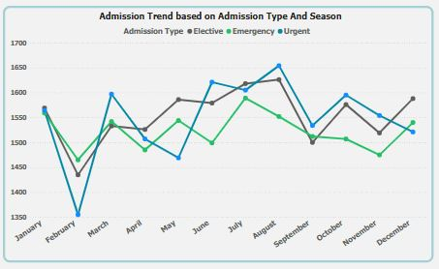
Admission Type Vs Seasonality
Science Presentation
2. What are the trends in hospital admissions based on admission type and seasonality?

Slide 13
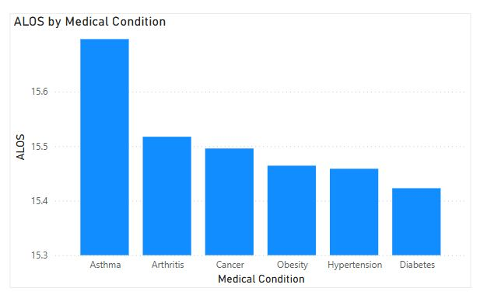
Average Length Of Stay
Science Presentation
3. How does the length of hospital stay vary across different admission types and medical conditions?

Slide 14
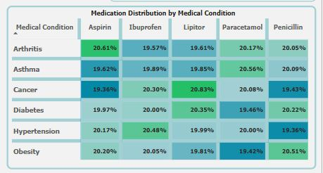
Medical Conditions Vs Prescriptions
Science Presentation
4. What is the relationship between medical conditions and prescribed medications?

Slide 15
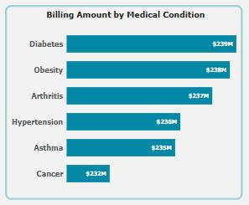
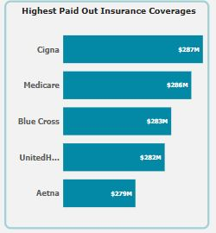
Medical Conditions Vs Billing Amount By Insurance Provider
Science Presentation
5. How do billing amounts vary by insurance provider and medical condition?

Slide 16

Drawing
a Conclusion
Drawing a Conclusion
Group 4 SABI DA25

Slide 17
OBSERVATIONS
Objective
Group 4 - SABI DA25
Based on a careful and detailed analysis of the dataset provided we have the following observations.
1. Emergency Admissions
- There is a high number of emergency cases due to late stage medical attention to patient’s conditions.
2. Chronic Diseases
- We observe a high prevalence of chronic diseases such as (arthritis, diabetes, hypertension, obesity) in California.
3. Average Billings by Admission Type
- Elective treatments have slightly higher costs than emergency/urgent care.
4. Average Billings by Medical Condition
- Obesity and diabetes have the highest average costs ($25,805 and $25,638, respectively)

Slide 18
Conclusions
Group 4 SABIDA25
CONCLUSIONS
Conclusions are as follows;
1)High Emergency Admissions: The distribution is fairly balanced but a high number of emergency cases suggests lack of preventive care leading to late stage medical attentions.
2)High Prevalence of Chronic Diseases:Chronic diseases (arthritis, diabetes, hypertension, and obesity) dominate, suggesting an urgent need for preventive healthcare programs.
3) Average Billings by Admission type:Elective treatments have slightly higher costs than emergency or urgent care, suggesting planned procedures may involve more extensive care or longer hospital stays.
4) Average Billings by Medical conditions:Obesity ($25,805) and diabetes ($25,638) have the highest average costs, reinforcing the importance of early intervention and lifestyle modifications.

Slide 19
Conclusions
Group 4 SABIDA25
RECOMMENDATIONS
The following recommendations are advised based on our observations and conclusions reached:
1)The government can enhance preventive care by expanding wellness programs for Obesity, Diabetes and hypertension to reduce emergency cases
2)With Support and subsidization for Chronic Disease Management Insurance providers can offer affordable treatment plans for conditions with high costs (obesity, diabetes).
3) Resource allocation improvements should be considered to optimize admission processes If elective procedures contribute to long wait times or high costs,
4)To enhance diagnostic accuracy due to high rate of test results that are inconclusive or abnormal, hospitals should improve lab testing capabilities and review current testing protocols.
5)Regulatory bodies should Investigate the impact of different insurance providers on billing amounts to ensure fair pricing.

Slide 20
Appendix
Group 4 SABI DA25
Source
This Dataset was sourced from Kaggle via the link https://www.kaggle.com/datasets/prasad22/healthcare-dataset
GROUP 4 PROJECT TEAM
Aje Abisola
Loto Olanrewaju Desmond
Ariseloye Paul
Ogboru Gospel

Slide 21
Appendix
Group 4 SABI DA25
THANK YOU

